Slide 1

Paymodoro
The cash sharing app to stay on track!

Slide 2


Team 2
Casey
Dan
Runhui
Jiamin
Deepali

Slide 3
Agenda
What is Paymodoro?
Market analysis
Business model and marketing
Paymodoro app: design and features
Challenges and lessons learned
Next Steps and Long-Term Strategies
Notes:
Casey

Slide 4
What is Paymodoro?
“Pomodoro technique” is a productivity method
Long focus intervals and short breaks
Named after a tomato (pomodoro in Italian) shaped timer
Paymodoro is an incentivizing timer
Users choose time interval
Incentive: financial buy-in
Incentive: app monitors user phone behavior
Forfeited cash is paid to winners and the app
Notes:
Casey, Dan

Slide 5
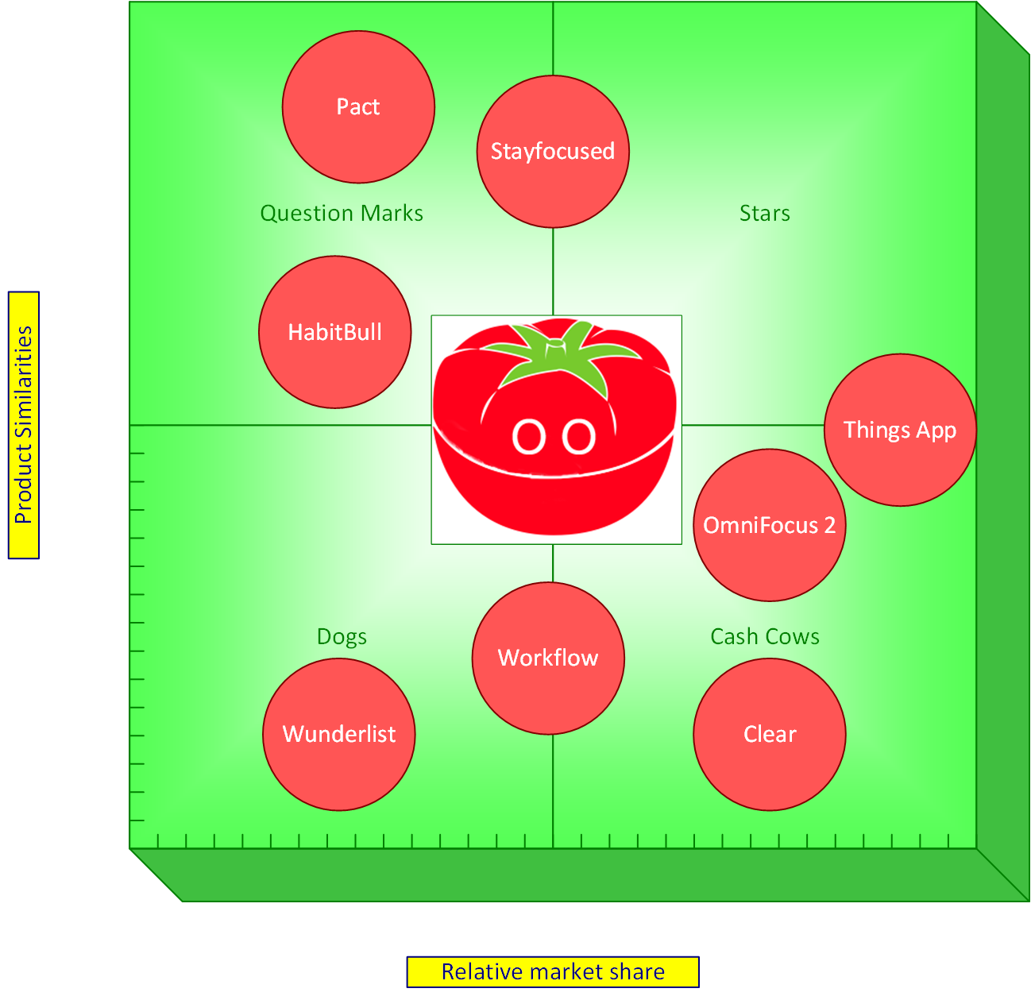
Market Analysis

Slide 6
Business model and marketing
Business Model
Free to download
Cash collected from forfeiting users
May generate cyclical revenue streams
Market Positioning
Capture the student market
Popular during exams (now)
Working professionals
Position as a productivity/ game crossover
Notes:
Dan

Slide 7
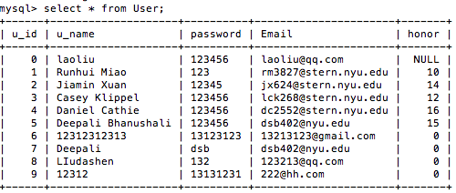

Paymodoro app: Backend Design
<eg, database design>
We use the ajax to communicate with php file in server and html files in the clients by Json. And thank Nedfex Liu for his help to separate the files.
Notes:
Runhui

Slide 8
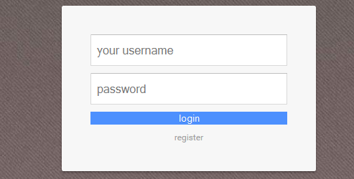
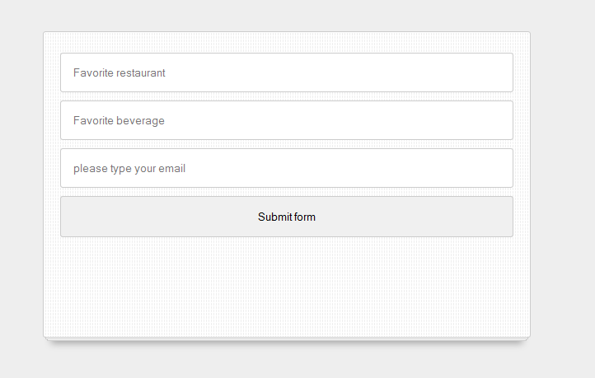
Paymodoro app: Backend Design
Notes:
Jiamin

Slide 9
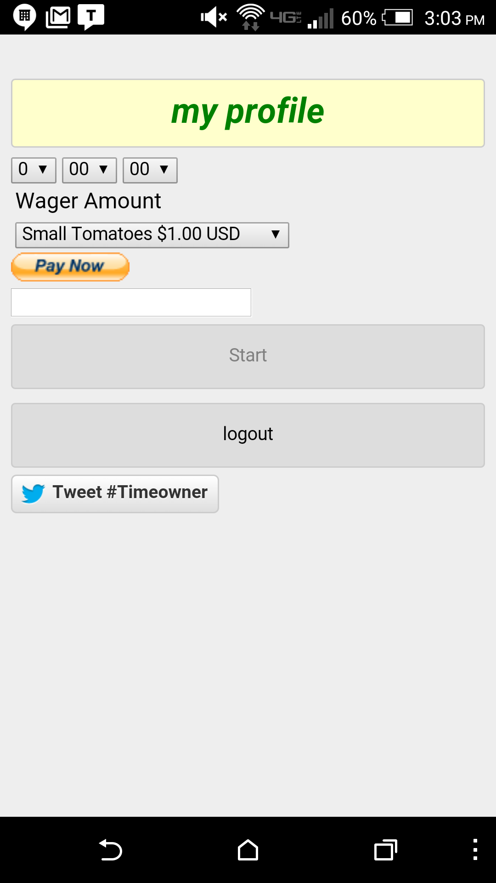
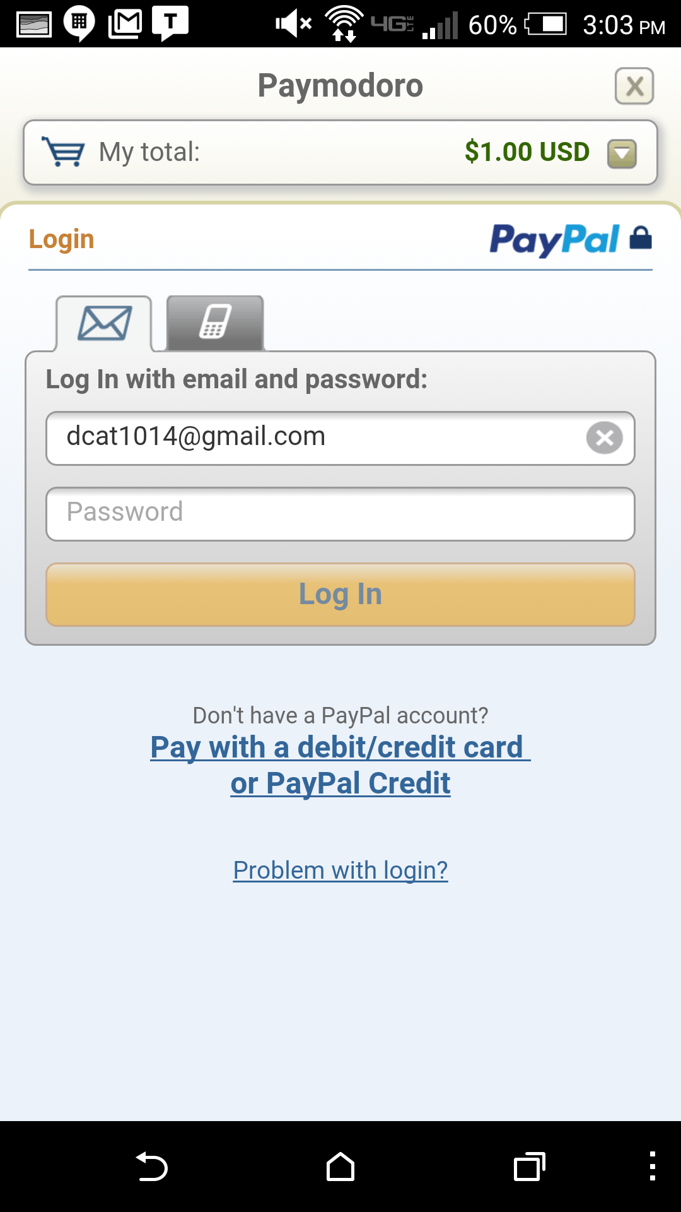
Paymodoro App: Front End Functionality
Notes:
Deepali

Slide 10
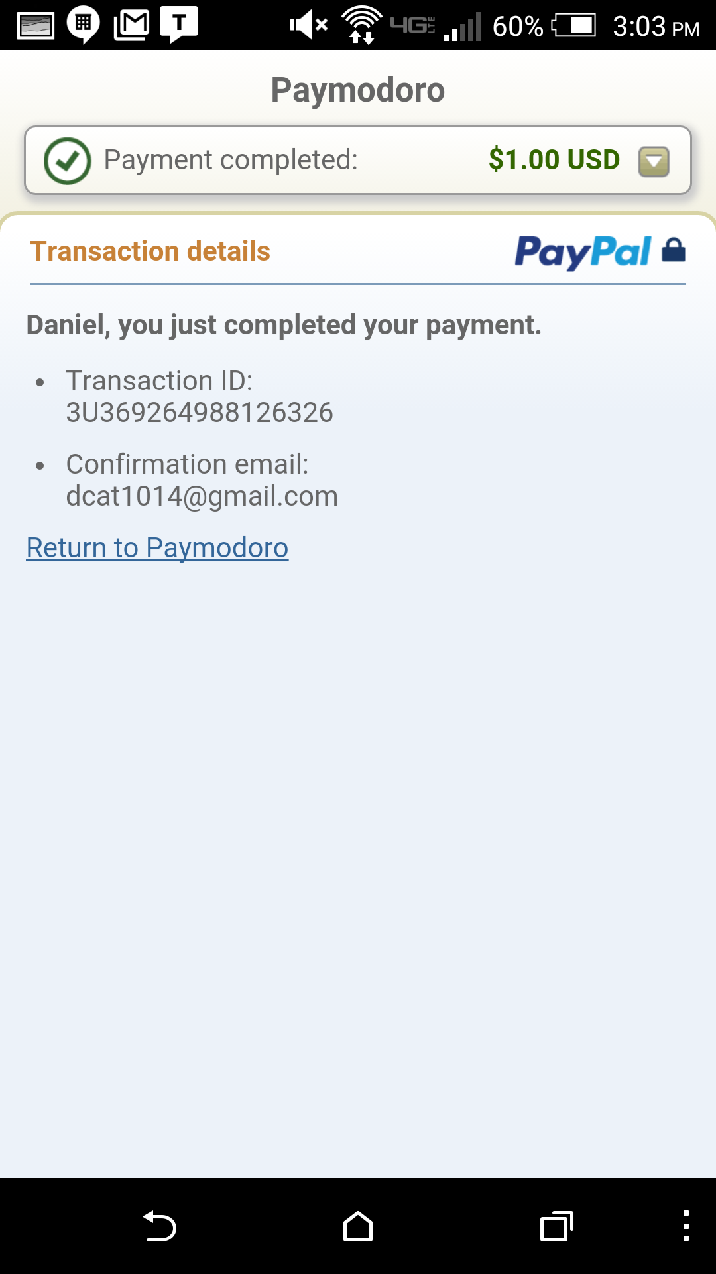
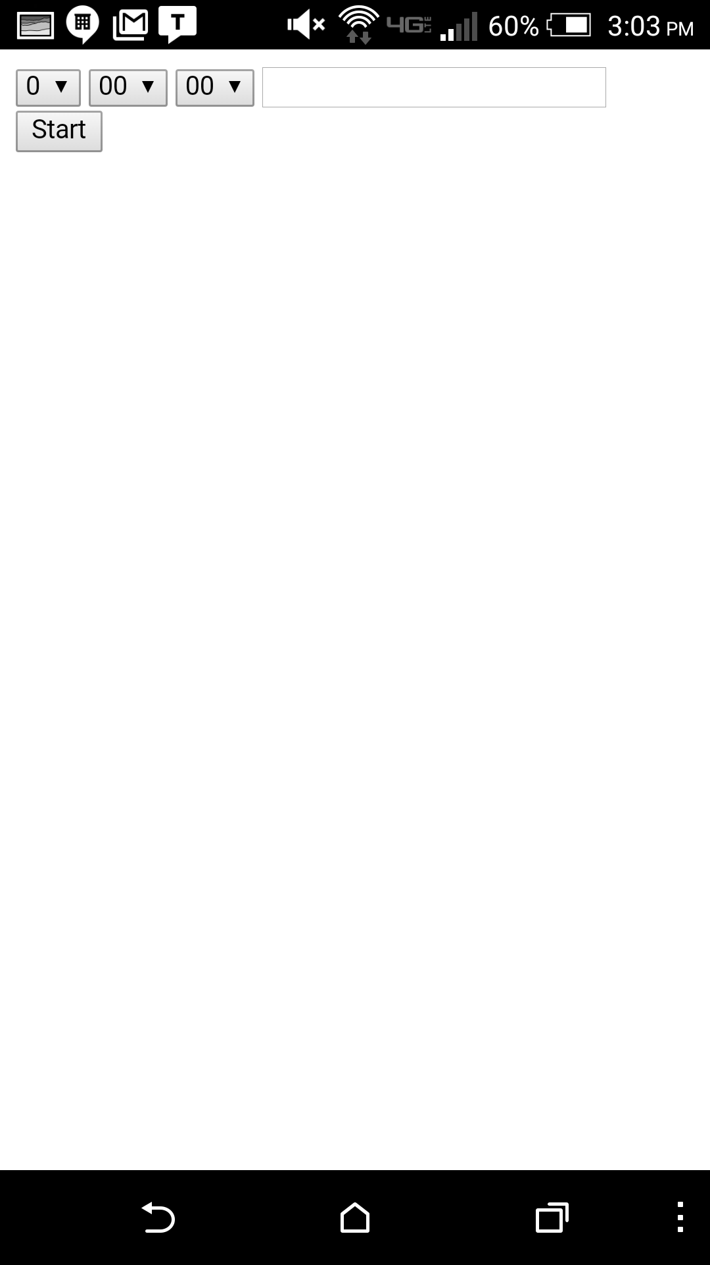

Slide 11
Challenges and Lessons
Backend/ frontend interdependence
Complexity refocuses priorities
Order of timer implementation, monitoring, and payment
Shifting Products Requirements
Original vision lacked specificity
API integration with Database

Slide 12
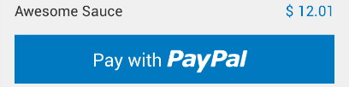
Next Steps, Long-Term Strategies
Next Steps
Still working on the first release
Integrate PayPal Mobile SDK for sending payments & persistent login
Integrate our 25 Minute Cycle Timer with global timer
Integrate background detection with phonegap
Long Term
Social wagering feature could be added
Longer term, a larger variety of incentives to encourage user retention

